Slide 1



AGE 214: Lecture 15
Power Electronics & Transducers
Sokoine University of Agriculture
AGE 214 - Lecture 15

Slide 2


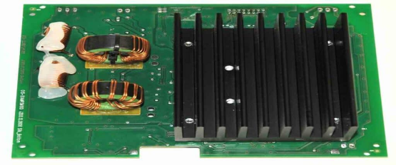
What is Power Electronics?
Definition
The application of solid-state electronics to the control and conversion of electric power.
•
Goal: Efficiently switch high voltages and currents.
•
Devices: Thyristors, Power MOSFETs, IGBTs.
•
Applications: Motor control (tractors), Solar inverters, Power grids.
Sokoine University of Agriculture
AGE 214 - Lecture 15

Slide 3

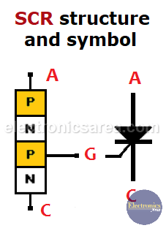
The Thyristor Family: SCR
Structure
•
4 Layers: P-N-P-N.
•
3 Terminals: Anode (A), Cathode (K), and Gate (G).
•
It acts like a Latching Switch.
Unlike a BJT, once an SCR is triggered ON, it stays ON even if the Gate signal is removed.
Sokoine University of Agriculture
AGE 214 - Lecture 15

Slide 4
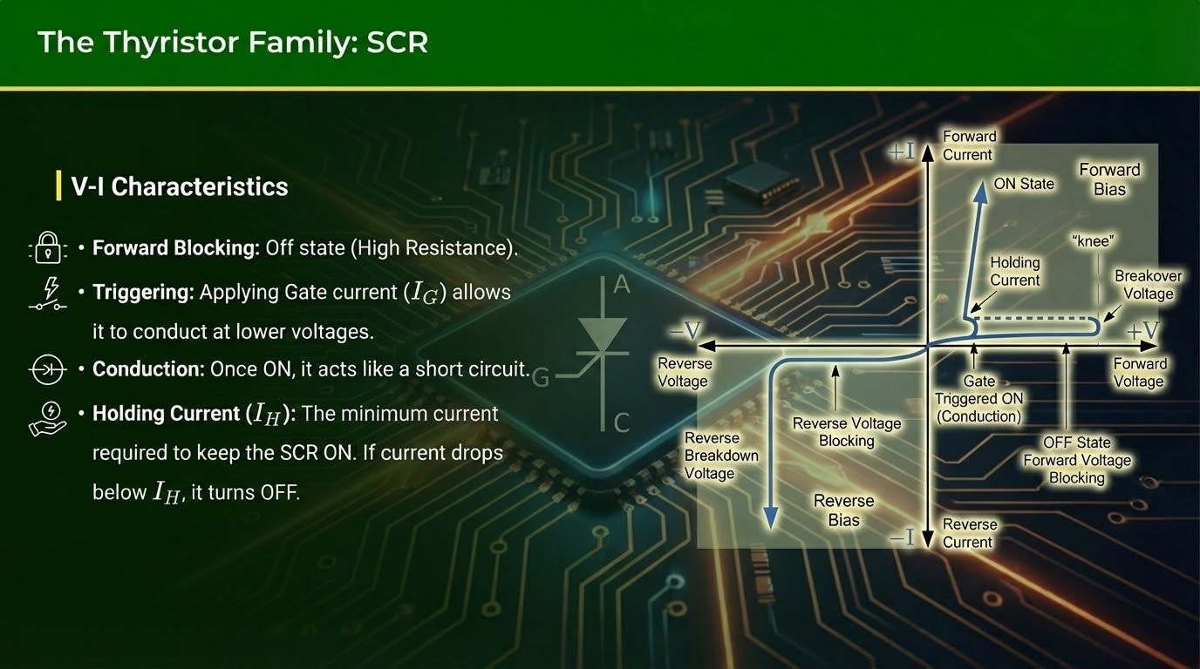

Slide 5






What is a Transducer?
Definition
Sensor (Input)
Actuator (Output)
A device that converts energy from one form to another.
Converts physical quantity (Heat, Light) into Electrical Signal.
Converts Electrical Signal into Physical Action.
Ex: Motor, Speaker, LED.
Ex: Thermocouple, Microphone.
Sokoine University of Agriculture
AGE 214 - Lecture 15

Slide 6
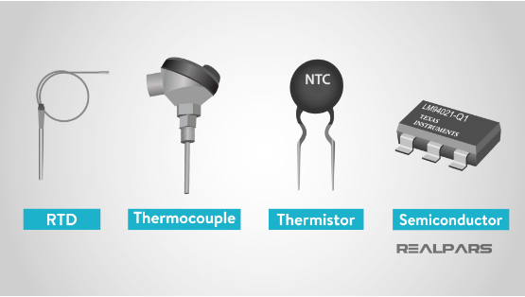
Temperature Transducers
1. Thermistor
Thermally Sensitive Resistor.
•
NTC (Negative Temp Coeff): Resistance drops as Temp rises.
•
High sensitivity, non-linear.
2. RTD (Resistance Temp Detector)
Made of Platinum (Pt100). Very linear and stable.
Sokoine University of Agriculture
AGE 214 - Lecture 15

Slide 7
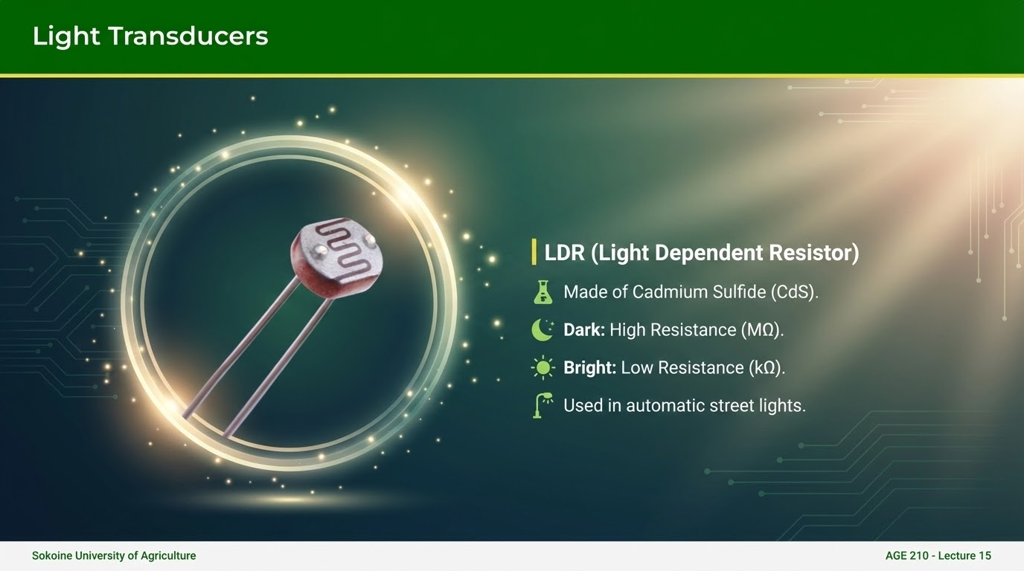

Slide 8
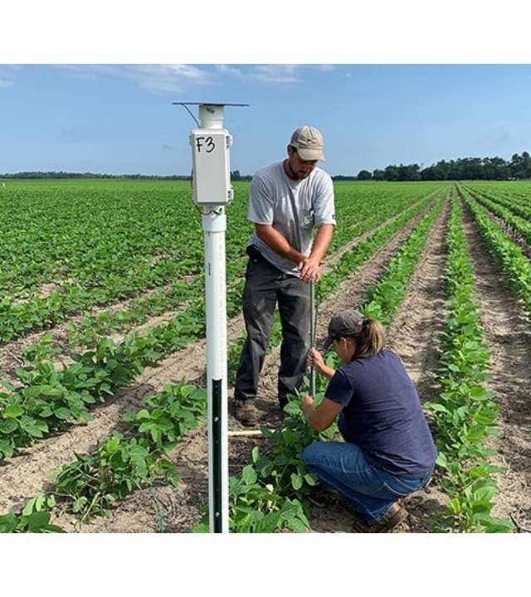
Electronics in Agriculture
Transducers are the eyes and ears of modern farming.
•
Soil Moisture Sensors: Measure conductivity (dielectric constant) to automate irrigation.
•
pH Sensors: Monitor soil acidity.
•
Load Cells: Weighing harvest yields.
•
Drones: Using spectral sensors for crop health.

Slide 9
Course Wrap-Up
Component | Key Function | Application
Diode | One-way valve | Rectification (AC to DC)
BJT | Current Amplifier | Amplifiers, Switches
FET | Voltage Control | Digital Logic, High Z Input
Op-Amp | Math Operations | Signal Processing
SCR | Latching Switch | High Power Control
Sokoine University of Agriculture
AGE 214 - Lecture 15

Slide 10

Thank You!
End of AGE 214 Course
Good luck with your exams!
Sokoine University of Agriculture
AGE 214 - Lecture 15

Slide 11






Image Sources
https://hillmancurtis.com/wp-content/uploads/2023/08/Heat-sink-1024x427.jpg
Source: hillmancurtis.com
https://electronicsarea.com/wp-content/uploads/SCR-structure-symbol.png
Source: electronicsarea.com
https://electronicspost.com/wp-content/uploads/2015/07/V-I-Characteristics-of-SCR-e1494004646123.png
Source: electronicspost.com
https://cdn.prod.website-files.com/65f854814fd223fc3678ea53/65f854814fd223fc3678f105_What-is-a-Temperature-Sensor.png
Source: www.realpars.com
https://lab.arts.ac.uk/uploads/images/gallery/2022-06/scaled-1680-/O2xOAG5EYsGx9hWE-light-dependent-resistor.png
Source: lab.arts.ac.uk
https://news.clemson.edu/wp-content/uploads/2021/08/Updated-Joe-Oswald-Dana-Turner-CIG-trial-feature-photo.jpg
Source: clemson.edu

